Slide 1
Chi Square Analysis_Day_16

Slide 2
Learning Objectives
Understand the χ² goodness-of-fit test and how to use it.
Analyze data using the χ² test of independence.

Slide 3
χ² Goodness-of-Fit Test
The χ² goodness-of-fit test compares expected (theoretical) frequencies of categories from a population distribution to the observed (actual) frequencies from a distribution to determine whether there is a difference between what was expected and what was observed.
Chi-square goodness-of-fit test is used to analyze probabilities of multinomial distribution trials along a single dimension.

Slide 4
χ² Goodness-of-Fit Test
The formula which is used to compute the test statistic for a chi-square goodness-of-fit test is given below.

Slide 5
χ² Goodness-of-Fit Test
The formula compares the frequency of observed values to the frequency of the expected values across the distribution.
Test loses one degree of freedom because the total number of expected frequencies must equal the number of observed frequencies
The chi-square distribution is the sum of the squares of k independent random variables.
Can never be less than zero; it extends indefinitely in the positive direction

Slide 6
Milk Sales Data for Demonstration Problem
Dairies would like to know whether the sales of milk are distributed uniformly over a year so they can plan for milk production and storage. A uniform distribution means that the frequencies are the same in all categories. In this situation, the producers are attempting to determine whether the amounts of milk sold are the same for each month of the year. They ascertain the number of gallons of milk sold by sampling one large supermarket each month during a year, obtaining the following data. Use .01 to test whether the data fit a uniform distribution.

Slide 7
Milk Sales Data for Demonstration Problem
Month
Gallons
January
1,610
February
1,585
March
1,649
April
1,590
May
1,540
June
1,397
July
1,410
August
1,350
September
1,495
October
1,564
November
1,602
December
1,655
18,447

Slide 8
Hypotheses and Decision Rules for Demonstration Problem

Slide 9
Calculations for Demonstration Problem
Month
f_{o}
f_{e}
(f_{o} - f_{e})²/f_{e}
January
1,610
1,537.25
3.44
February
1,585
1,537.25
1.48
March
1,649
1,537.25
8.12
April
1,590
1,537.25
1.81
May
1,540
1,537.25
0.00
June
1,397
1,537.25
12.80
July
1,410
1,537.25
10.53
August
1,350
1,537.25
22.81
September
1,495
1,537.25
1.16
October
1,564
1,537.25
0.47
November
1,602
1,537.25
2.73
December
1,655
1,537.25
9.02
18,447
18,447.00
74.38

Slide 10
Calculations for Demonstration Problem
The observed chi-square value of 74.37 is greater than the critical value of 24.725.
The decision is to reject the null hypothesis. The data provides enough evidence to indicate that the distribution of milk sales is not uniform.

Slide 11
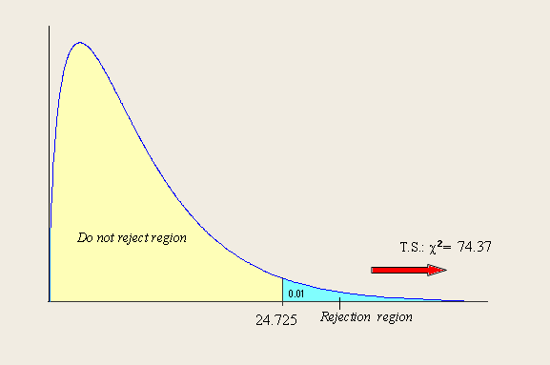
Calculations for Demonstration Problem

Slide 12
Bank Customer Arrival Data for Demonstration Problem
An earlier chapter indicated that, quite often in the business world, random arrivals are Poisson distributed. This distribution is characterized by an average arrival rate, λ, per some interval. Suppose a teller supervisor believes the distribution of random arrivals at a local bank is Poisson and sets out to test this hypothesis by gathering information. The following data represent a distribution of frequency of arrivals during 1-minute intervals at the bank. Use α = .05 to test these data in an effort to determine whether they are Poisson distributed.

Slide 13
Bank Customer Arrival Data for Demonstration Problem
Number of
Observed
Arrivals
Frequencies
0
7
1
18
2
25
3
17
4
12
≥5
5

Slide 14
Hypotheses and Decision Rules for Demonstration Problem

Slide 15
Calculations for Demonstration Problem : Estimating the Mean Arrival Rate
Number of
Observed
Mean
Arrival
Rate
Arrivals
X
Frequencies
f
f·X
0
7
0
1
18
18
2
25
50
3
17
51
4
12
48
≥5
5
25
192

Slide 16
Calculations for Demonstration Problem : Poisson Probabilities for λ = 2.3
Expected
Expected
Number of
Probabilities
Frequencies
Arrivals X
P(X)
n·P(X)
0
0.1003
8.42
1
0.2306
19.37
2
0.2652
22.28
3
0.2033
17.08
4
0.1169
Poisson
Probabilities
for λ = 2.3
9.82
≥5
0.0838
7.04

Slide 17
χ² Calculations for Demonstration Problem
Number of
Observed
Expected
(f_{o} - f_{e})²
f_{e}
Arrivals
X
Frequencies
f
Frequencies
nP(X)
0
7
8.42
0.24
1
18
19.37
0.10
2
25
22.28
0.33
3
17
17.08
0.00
4
12
9.82
0.48
≥5
5
7.04
0.59
84
84.00
1.74

Slide 18
Calculations for Demonstration Problem
The observed chi-square value of 1.74 is less than the critical value of 9.4877.
The decision is not to reject the null hypothesis. The data does not provide enough evidence to indicate that the distribution of bank arrivals is Poisson.

Slide 19
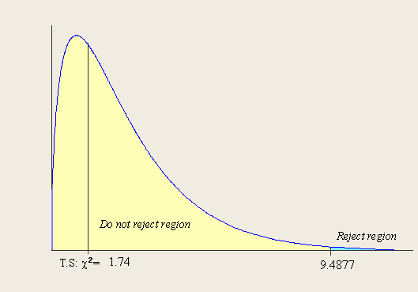
Calculations for Demonstration Problem

Slide 20
Using a χ² Goodness-of-Fit Test to Test a Population Proportion
f_{o}
f_{e}
Defects
33
16
Nondefects
167
184
n =
200
200

Slide 21
Using a χ² Goodness-of-Fit Test to Test a Population Proportion
The observed chi-square value of 19.63 is greater than the critical value of 2.7055.
The decision is to reject the null hypothesis. The manufacturer does not produce 8% defects according to the analysis.
Observing the actual sample result, in which 0.165 of the sample was defective, indicates that the proportion of the population that is defective might be greater than 8%.

Slide 22
Preference for Milk Data for Demonstration Problem
In a previous chapter, we tested to determine whether the residents of Wisconsin consume a significantly higher proportion of milk as their primary breakfast beverage than the .17 figure for the US as a whole.

Slide 23
Demonstration Problem Using a χ² Goodness-of-Fit Test to Test a Population Proportion: Calculations

Slide 24
Using a χ² Goodness-of-Fit Test to Test a Population Proportion
The observed chi-square value of 5.95 is greater than the critical value of 3.8415.
The decision is to reject the null hypothesis. The proportion of residents who drink milk as their primary breakfast beverage is higher in Wisconsin than in the US as a whole.

Slide 25
χ² Test of Independence
Chi-square goodness-of-fit test - used to analyze the distribution of frequencies for categories of one variable to determine whether the distribution of these frequencies is the same as some hypothesized or expected distribution.
The goodness-of-fit test cannot be used to analyze two variables simultaneously.
Chi-square test of independence - used to analyze the frequencies of two variables with multiple categories to determine whether the two variables are independent.

Slide 26
χ² Test of Independence
Different chi-square test, the chi-square test of independence, can be used to analyze the frequencies of two variables with multiple categories to determine whether the two variables are independent.
Used to analyze the frequencies of two variables with multiple categories to determine whether the two variables are independent

Slide 27
χ² Test of Independence: Gasoline Preference Versus Income Category
Suppose a business researcher wants to determine whether type of gasoline preferred is independent of a person’s income. She takes a random survey of gasoline purchasers, asking them one question about gasoline preference and a second question about income.
The respondent checks which gasoline he or she prefers
(1) regular, (2) premium, or (3) extra premium.
The respondent also is to check his or her income brackets as being (1) < $30,000, (2) $30,000 to $49,999, (3) $50,000 to $99,999, or (4) > $100,000.

Slide 28
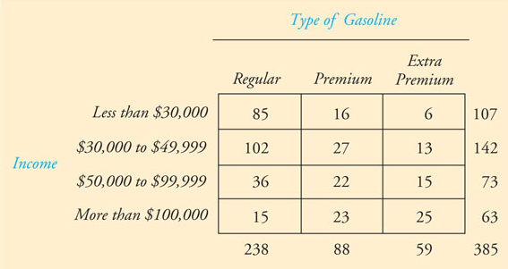
χ² Test of Independence: Type of Gasoline and Income Example
Hypotheses:
Using α = .01, she uses the chi-square test of independence to determine whether type of gasoline preferred is independent of income level.

Slide 29
χ² Test of Independence: Gasoline Preference Versus Income Category
Type of
r = 4
Gasoline
c = 3
Extra
Income
Regular
Premium
Premium
Less than $30,000
$30,000 to $49,999
$50,000 to $99,000
At least $100,000

Slide 30
Gasoline Preference Versus Income Category: Observed Frequencies
Type of
Gasoline
Extra
Income
Regular
Premium
Premium
Less than $30,000
85
16
6
107
$30,000 to $49,999
102
27
13
142
$50,000 to $99,000
36
22
15
73
At least $100,000
15
23
25
63
238
88
59
385

Slide 31
Gasoline Preference Versus Income Category: Expected Frequencies
(
(
)
Type of
n
)
n
e
i
j
Gasoline
=
ij
N
Extra
(
)
107
(
)
Income
e
238
Regular
Premium
Premium
=
11
385
Less than $30,000
(66.15)
(24.46)
(16.40)
=
66
85
16
6
107
.
15
(
)
$30,000 to $49,999
(87.78)
(32.46)
(21.76)
107
(
)
e
88
=
102
27
13
142
12
385
$50,000 to $99,000
(45.13)
(16.69)
(11.19)
=
24
.
46
36
22
15
73
(
)
107
(
)
e
59
At least $100,000
(38.95)
(14.40)
(9.65)
=
13
385
15
23
25
63
=
16
238
88
59
385
.
40

Slide 32
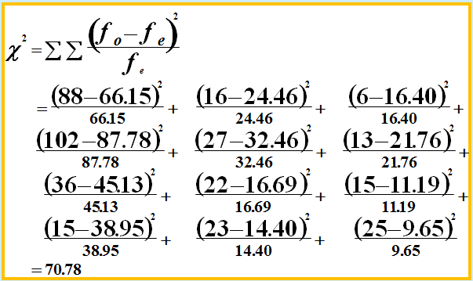
Gasoline Preference Versus Income Category: χ² Calculation

Slide 33
Gasoline Preference Versus Income Category
The observed chi-square value of 70.78 is greater than the critical value of 16.8119.
The decision is to reject the null hypothesis. The data does provide enough evidence to indicate that the type of gasoline preferred is not independent of income.

Slide 34
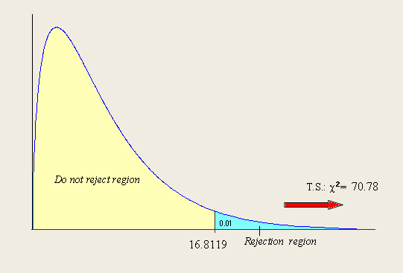
Gasoline Preference Versus Income Category: χ² Calculation

